Slide 1

Chapter 21
Network Layer: Address Mapping
Copyright © The McGraw-Hill Companies, Inc. Permission required for reproduction or display.

Slide 2
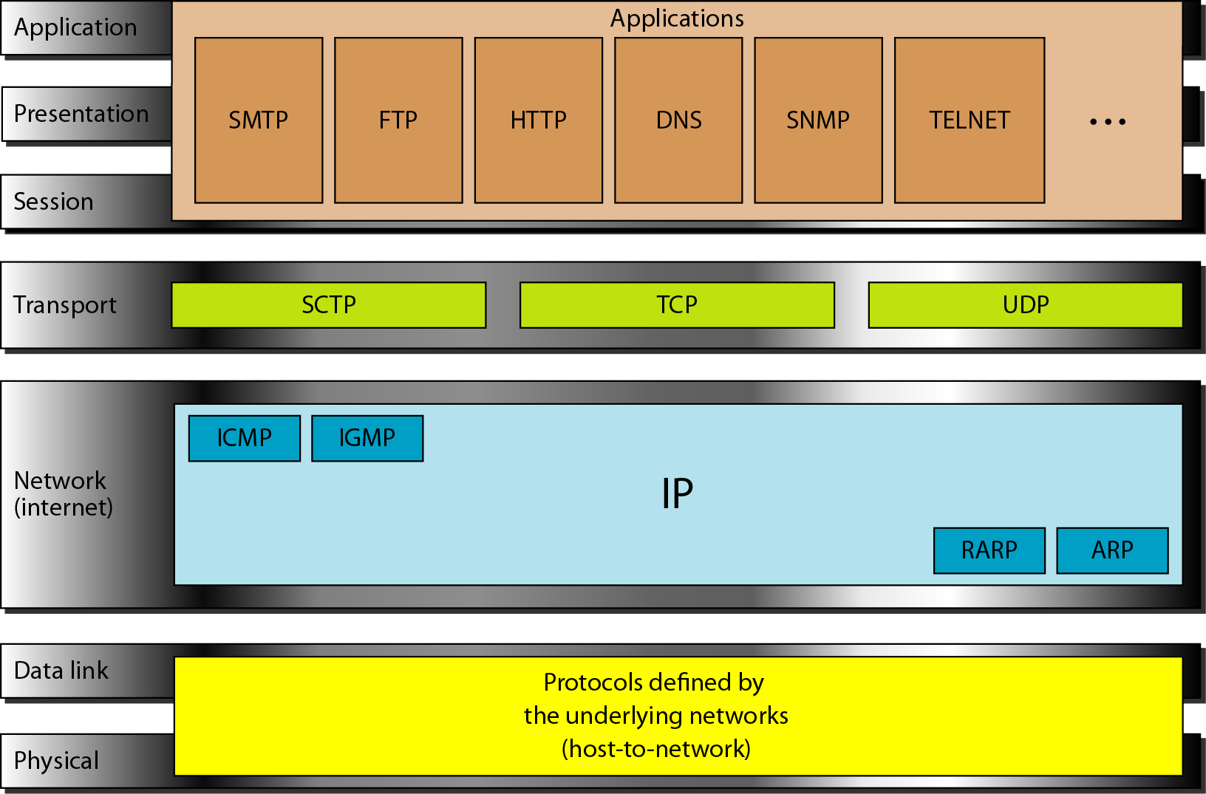
Figure 2.16 TCP/IP and OSI model

Slide 3
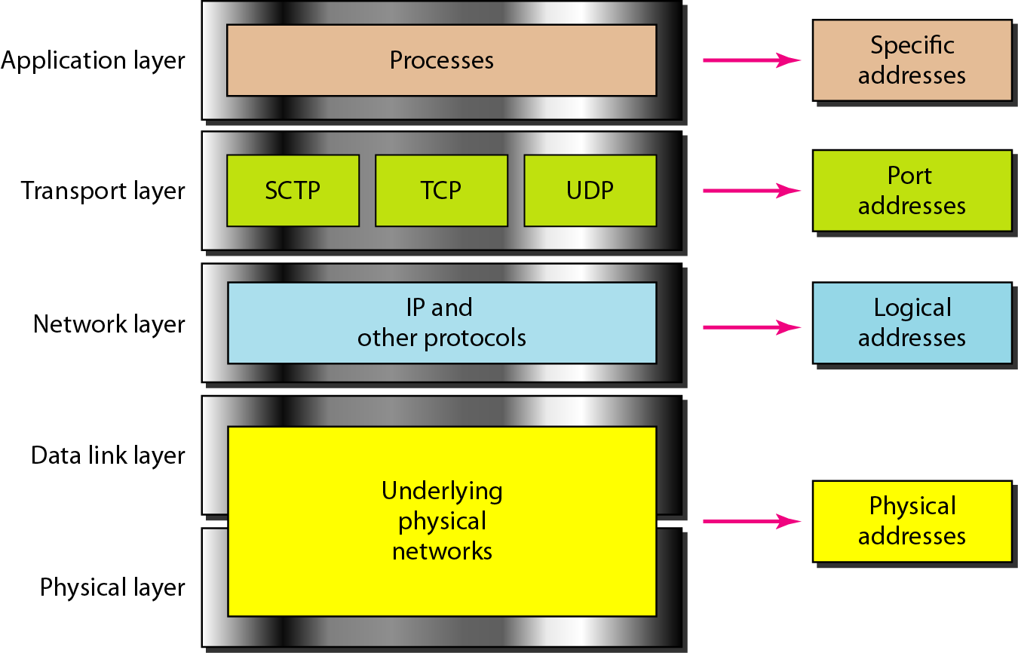
Figure 2.18 Relationship of layers and addresses in TCP/IP

Slide 4
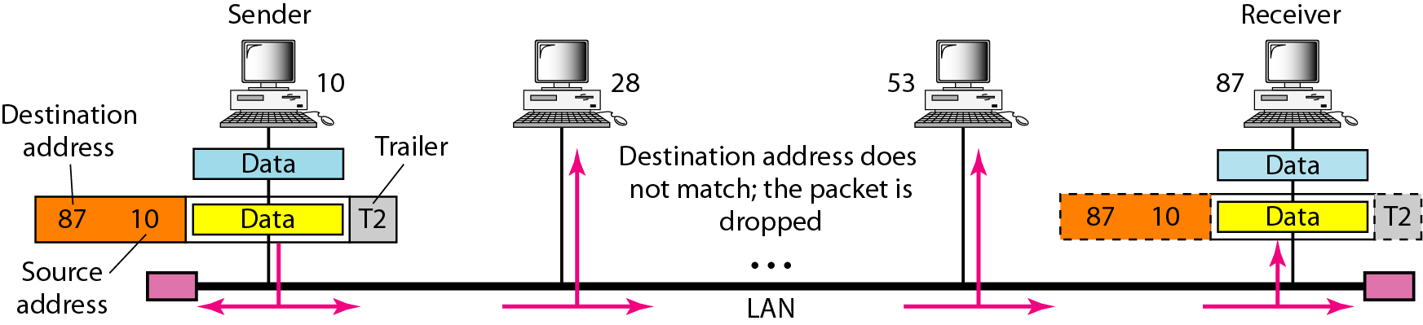
Figure 2.19 Physical addresses

Slide 5
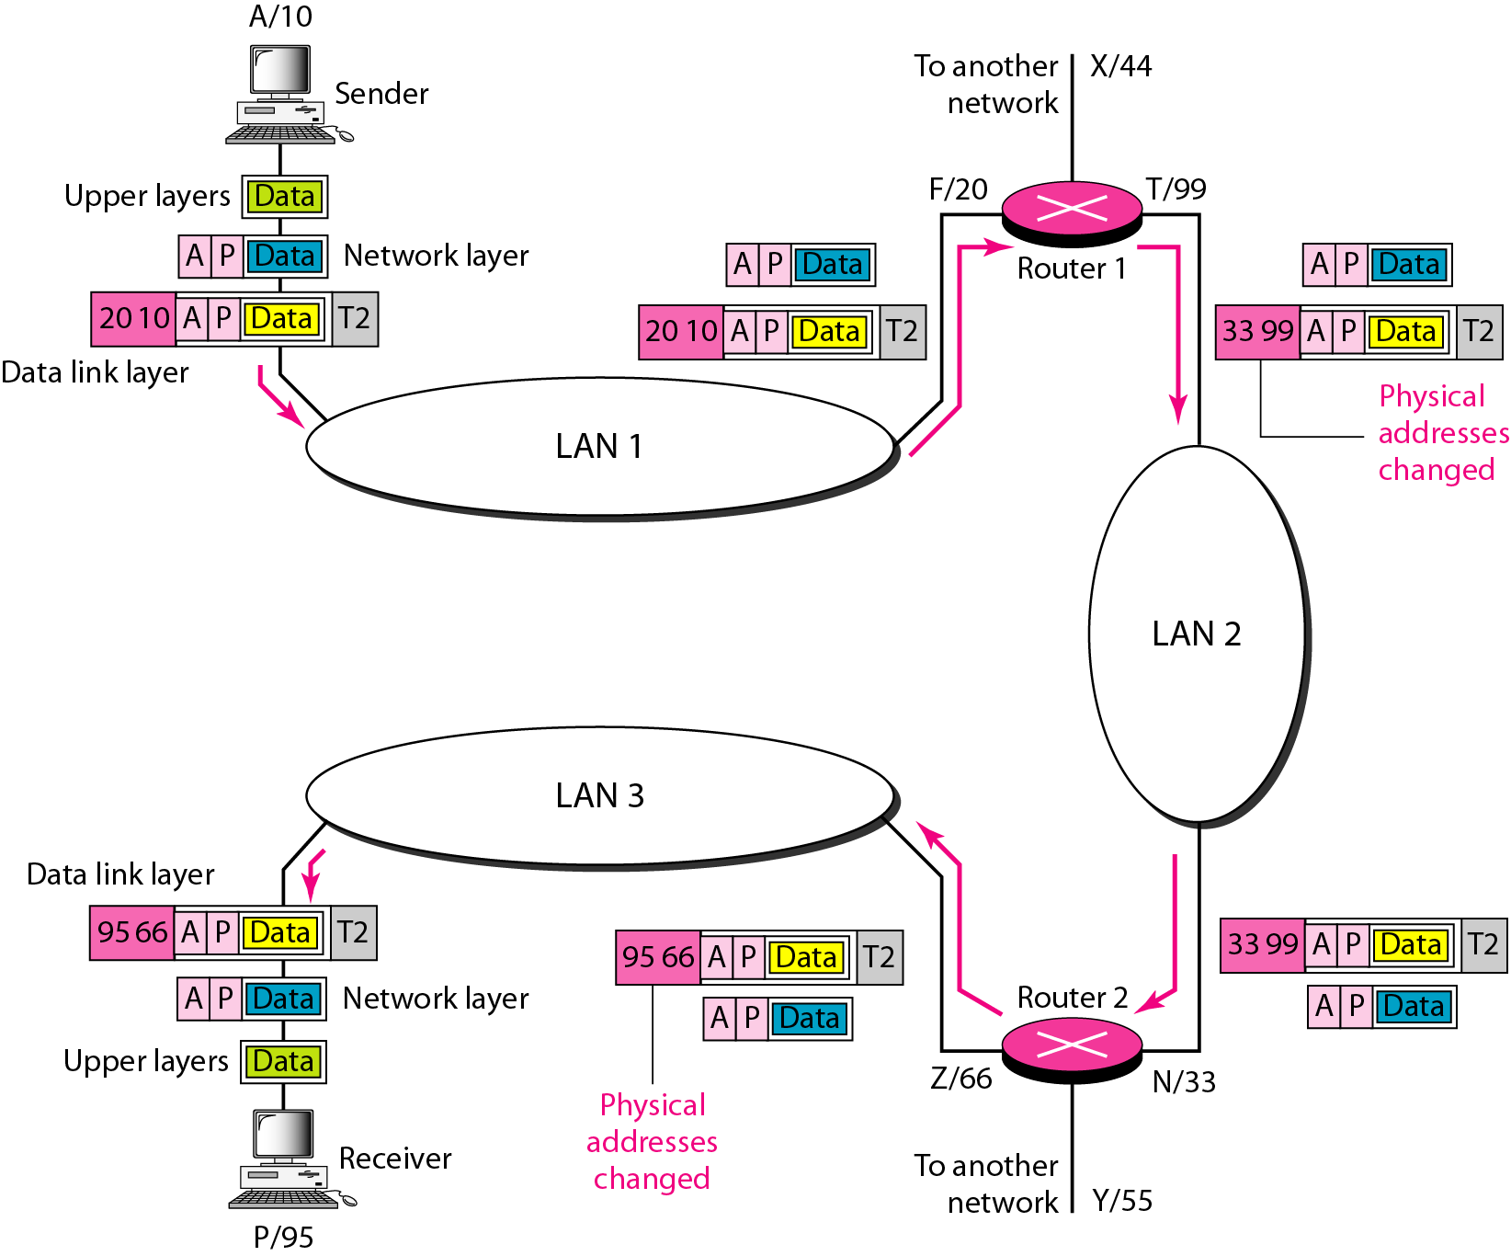
Figure 2.20 IP addresses

Slide 6
21-1 ADDRESS MAPPING
The delivery of a packet to a host or a router requires two levels of addressing: logical and physical. We need to be able to map a logical address to its corresponding
physical address and vice versa. This can be done by using either static or dynamic mapping.
Topics discussed in this section:
Mapping Logical to Physical Address
Mapping Physical to Logical Address

Slide 7
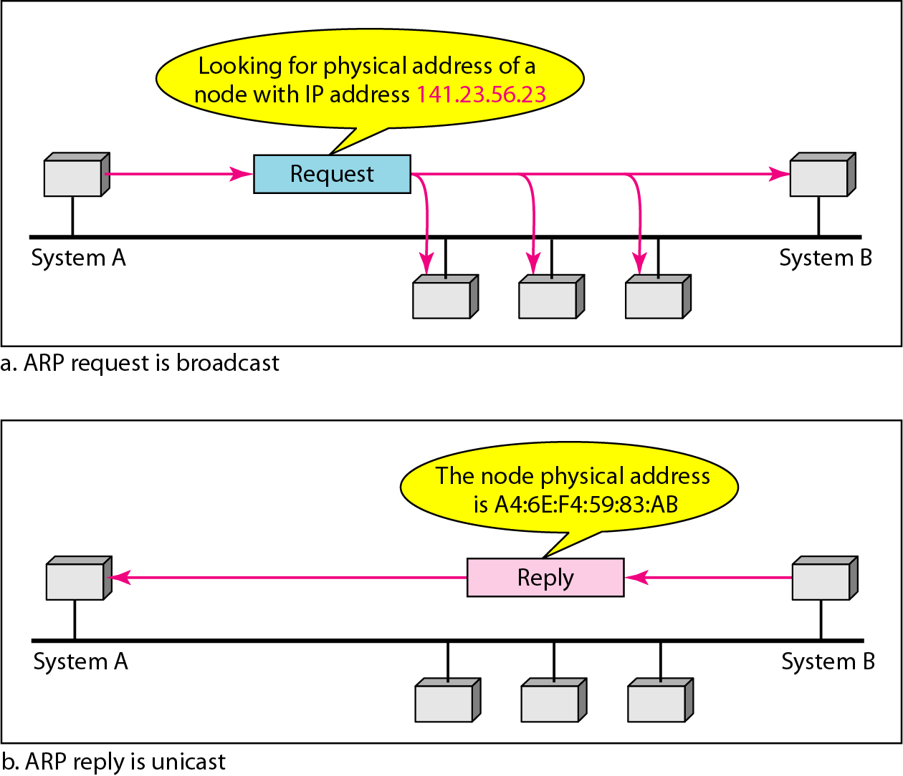
Figure 21.1 ARP operation

Slide 8
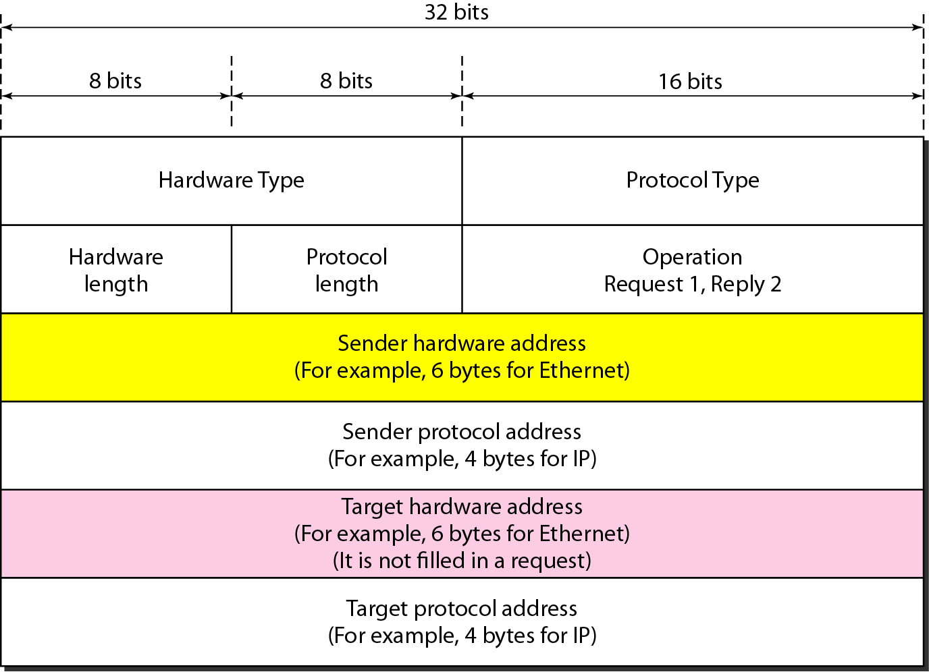
Figure 21.2 ARP packet

Slide 9
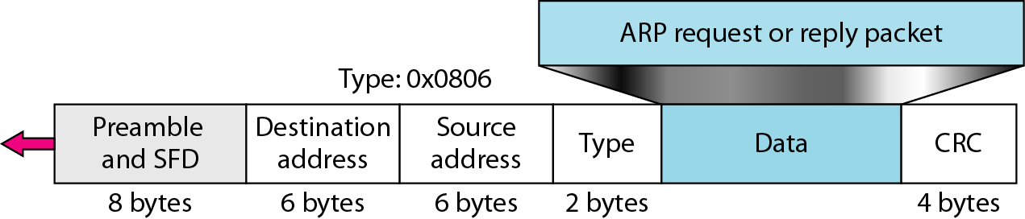
Figure 21.3 Encapsulation of ARP packet

Slide 10
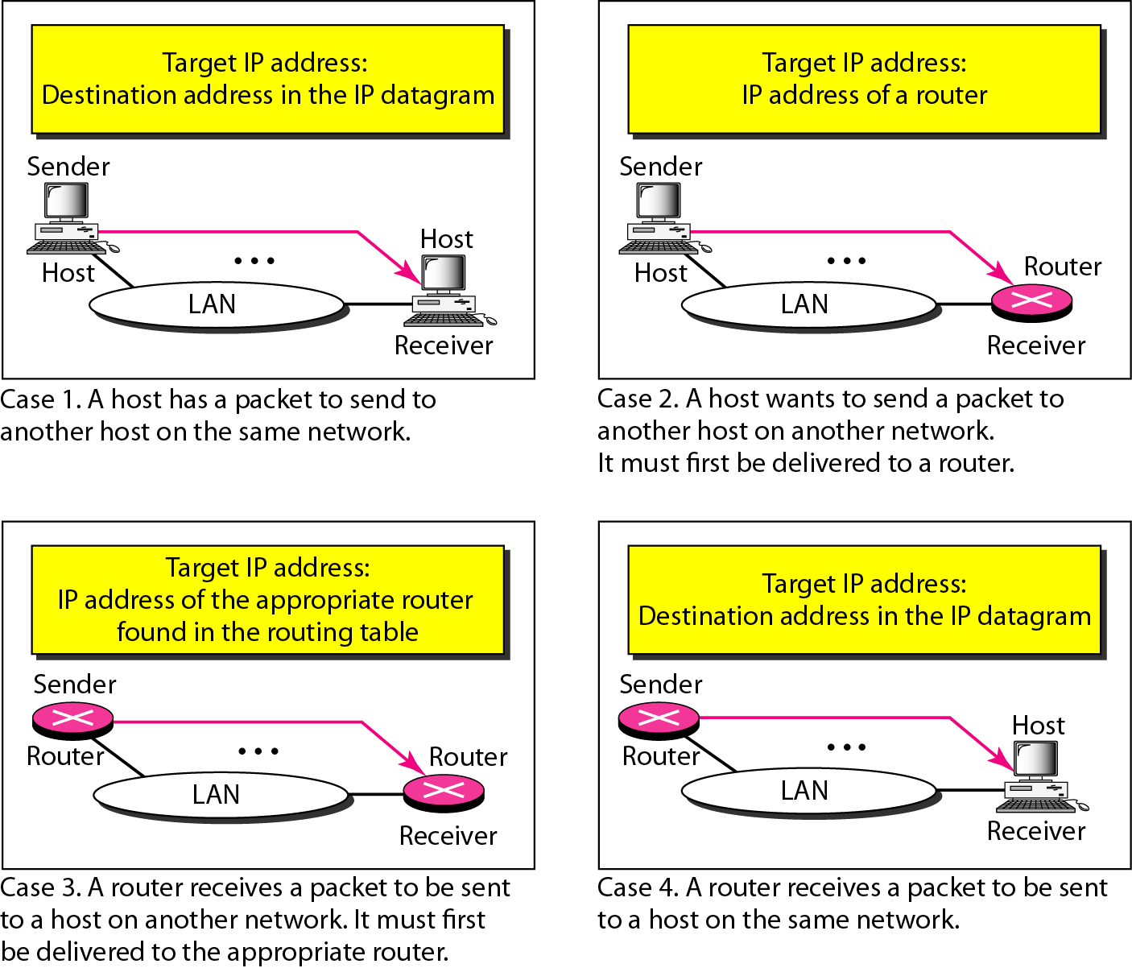
Figure 21.4 Four cases using ARP

Slide 11

Note
An ARP request is broadcast; an ARP reply is unicast.

Slide 12
Example 21.1
A host with IP address 130.23.43.20 and physical address B2:34:55:10:22:10 has a packet to send to another host with IP address 130.23.43.25 and physical address A4:6E:F4:59:83:AB. The two hosts are on the same Ethernet network. Show the ARP request and reply packets encapsulated in Ethernet frames.
Solution
Figure 21.5 shows the ARP request and reply packets. Note that the ARP data field in this case is 28 bytes, and that the individual addresses do not fit in the 4-byte boundary. That is why we do not show the regular 4-byte boundaries for these addresses.

Slide 13
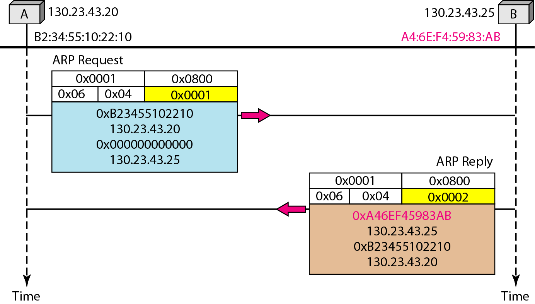
Figure 21.5 Example 21.1, an ARP request and reply

Slide 14
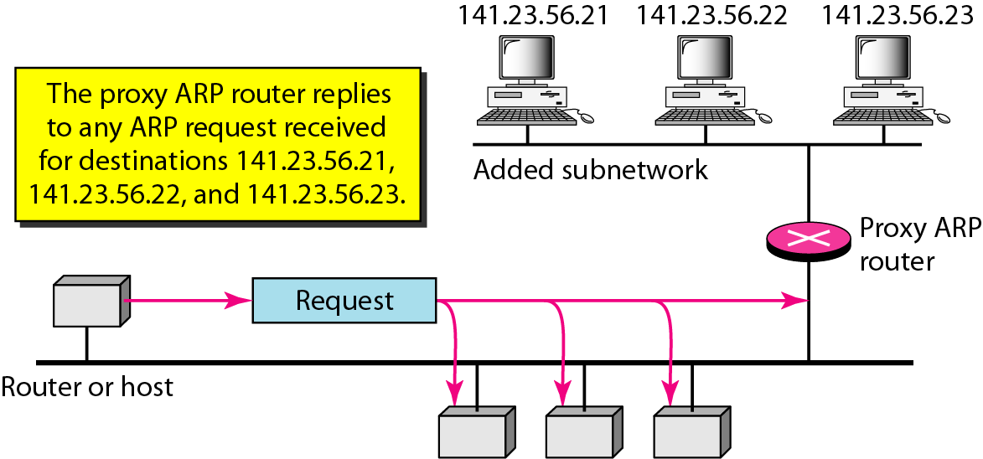
Figure 21.6 Proxy ARP

Slide 15
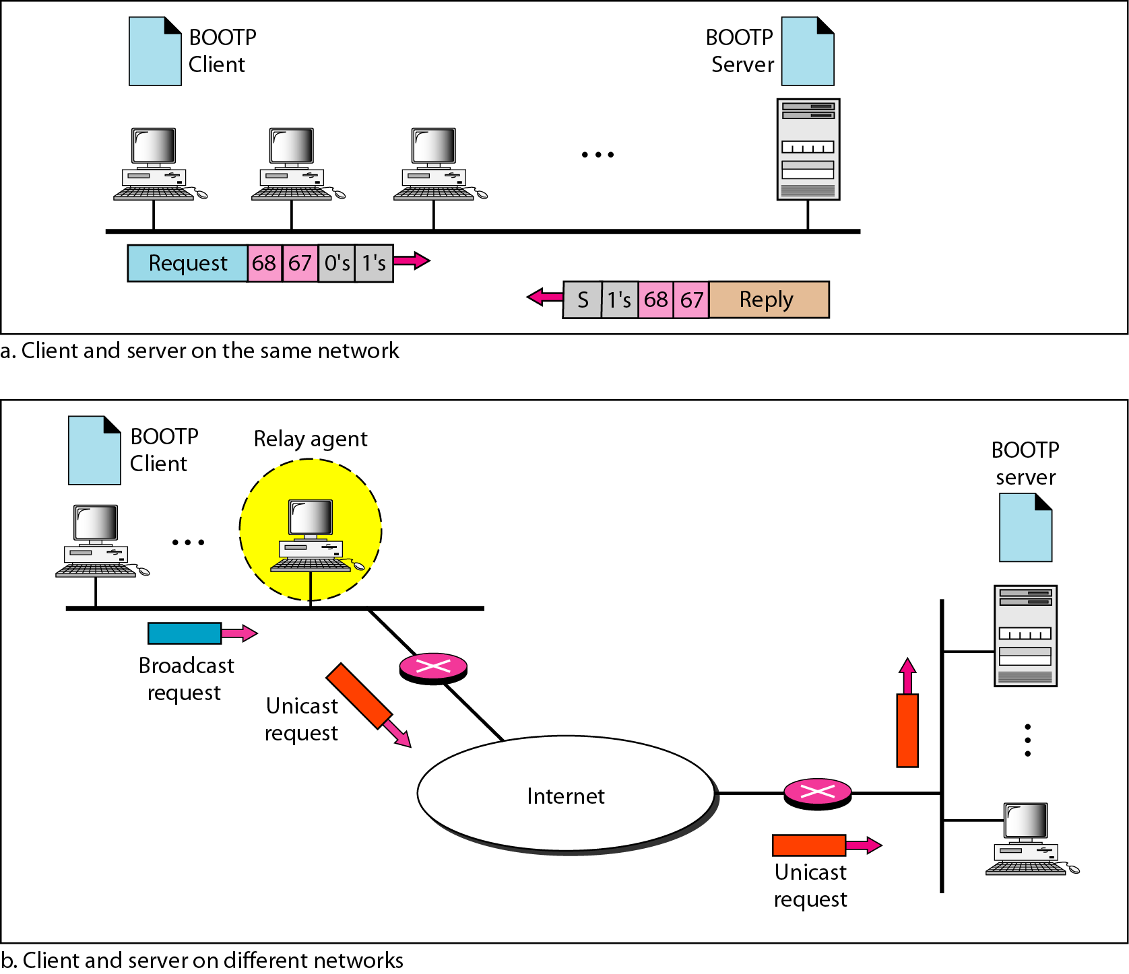
Figure 21.7 BOOTP client and server on the same and different networks

Slide 16
Note
DHCP provides static and dynamic address allocation that can be manual or automatic.

Slide 17
Chapter 21
Network Layer:
Error Reporting
Copyright © The McGraw-Hill Companies, Inc. Permission required for reproduction or display.

Slide 18
Figure 2.16 TCP/IP and OSI model

Slide 19
21-2 ICMP
The IP protocol has no error-reporting or error-correcting mechanism. The IP protocol also lacks a mechanism for host and management queries. The Internet Control Message Protocol (ICMP) has been designed to compensate for the above two deficiencies. It is a companion to the IP protocol.
Topics discussed in this section:
Types of Messages Message Format Error Reporting and Query
Debugging Tools

Slide 20
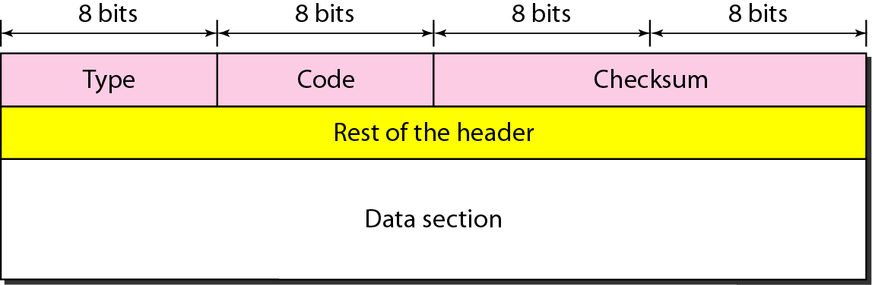
Figure 21.8 General format of ICMP messages

Slide 21
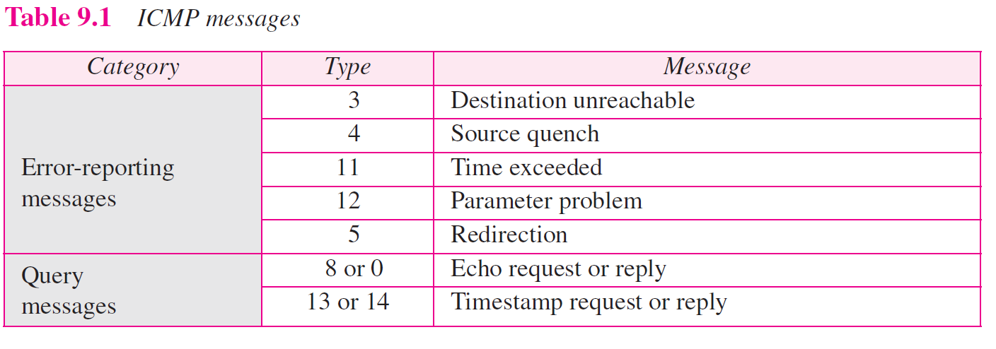
Figure 9.1 ICMP messages

Slide 22
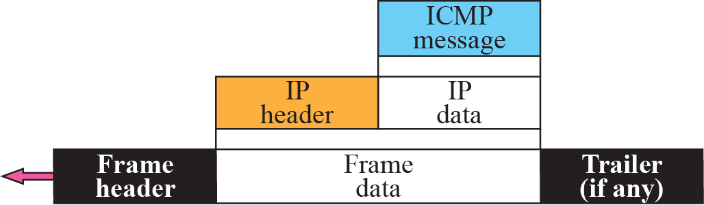
Figure 9.2 ICMP encapsulation

Slide 23
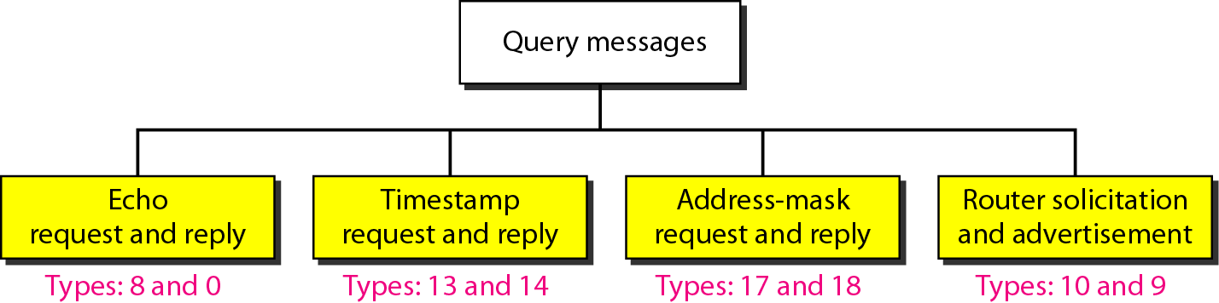
Figure 21.12 Query messages

Slide 24
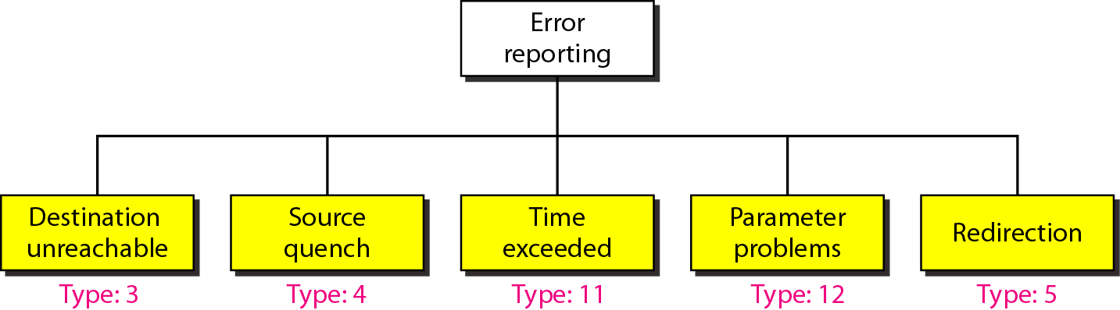
Figure 21.9 Error-reporting messages

Slide 25
